Slide 1
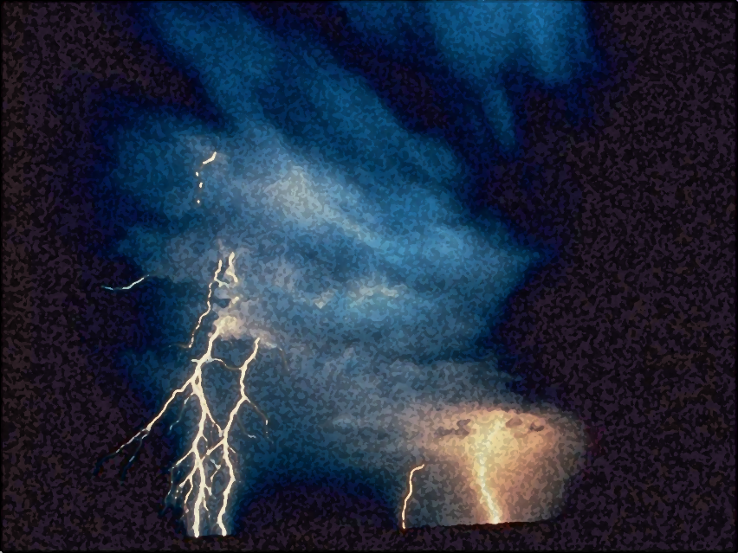

A Light out of Darkness
The Vision of Isaiah
Doom to Bloom

Slide 2


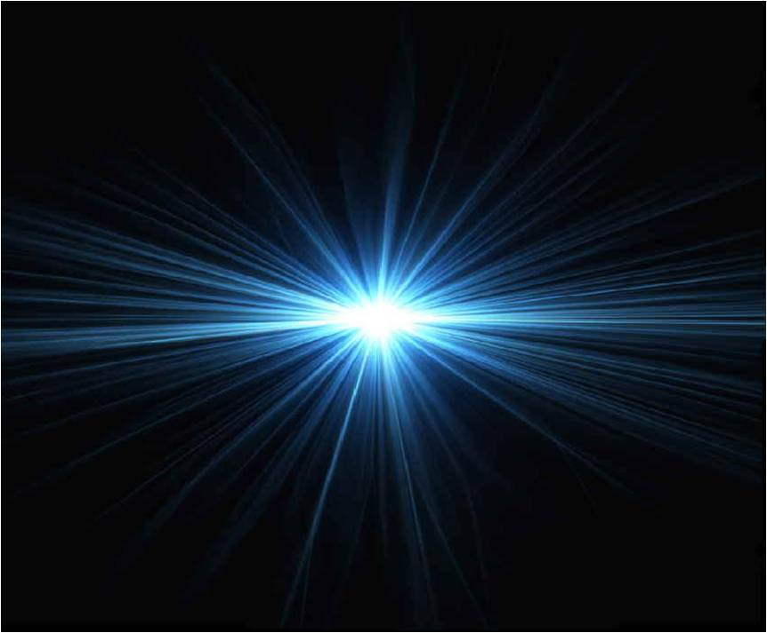
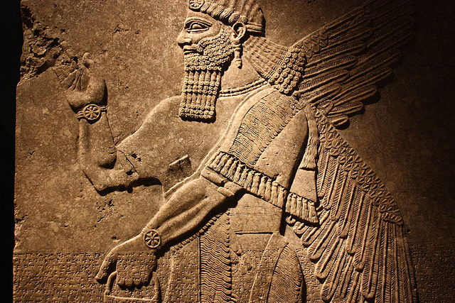
The Vision of Isaiah
God or Assyria?
An Example of Distrust
7-12
Notes:
In whom will Ahaz trust? The LORD of the universe of the lord of Assyria. In whom will we trust? God or Man. Will you choose light or darkness?
The primary reason King Ahaz does not and will not trust the LORD is due to his own pride and arrogance, which must be exposed. The proud will be cut down to size, and after the humiliation then trust can be exercised.

Slide 3
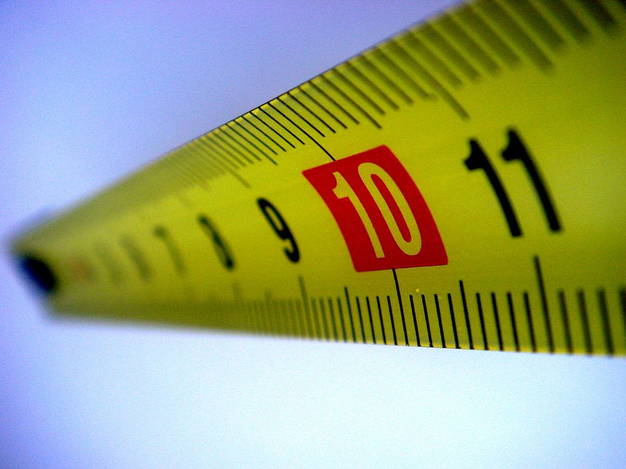
Will You Believe?
Measured by
God’s Standard
9:8 – 10:4
Notes:
This segment goes back to a previous section to answer the question, What will come of Ephraim’s plans against Judah to invade and dethrone King Ahaz, thus ending the Davidic Covenant.? Will Ahaz’s alliance with Assyria with their superior might save him and Judah?
“Isaiah’s answer is NO. It is not with Assyria with whom Ephraim and later Judah come to terms; it is God. The world is judged by God’s standards, standards which do not depend upon relative might but rather upon moral rectitude. If Ephraim goes under, it will not be because she was too weak militarily. It will be because she was measure according to the Sovereign’s moral standards and found lacking. It is not Assyria anger which Ephraim and Judah face but God’s”. (Oswalt, p. 250)
Assyria is seen as an instrument in the hands of God, herself accountable to the same standards as everyone else. The God who delivered His people into Assyria’s hand can also deliver them from that hand. In fact, He will do so, by the power of that messianic figure just described in the previous verses (9:1-7)

Slide 4
Will You Believe?
Offenses Against God
Pride and Arrogance
False Leadership
Devouring One’s Brother
Oppression of the Poor
Notes:
The content moves from pride, to false leadership, to the loss of brother love to social injustice – the oppression of the poor and helpless. All of these are the great themes of Isaiah’s book which were previously mentioned in chs. 2, 3, 5, which will be mentioned in chs. 13, 14, 28-31.
The root cause of the human problem is arrogance, which then leads to the other problems, the end which is oppression.
The prophet reminds his hearers of the human behavior for which we stand condemned at the bar of God and as a result of which all nations go down to destruction.
Doom and destruction is decreed against Israel for offense against a Holy God. The destruction will come Assyria who is merely a tool the hand of God to accomplish His purposes.

Slide 5
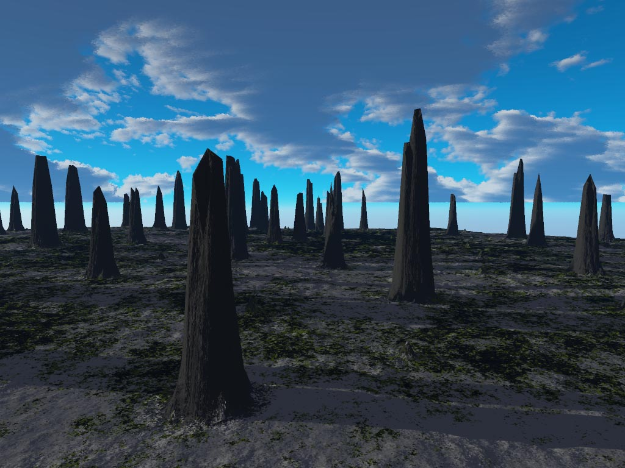
Will You Believe?
Doom and Destruction
is Decreed
Notes:
Doom and destruction is decreed against Israel for offense against a Holy God. The destruction will come Assyria who is merely a tool the hand of God to accomplish His purposes.
There is hope. Hope shines out of darkness. The gloom and the doom is not final. The darkness and emptiness is not an end in itself but a means whereby God’s goodness can be manifested in the salvation of the land.

Slide 6
Will You Believe?
Hope Despite Destruction
10:5 – 11:16
Notes:
Soon a shoot from the root of Jesse, and son of David will arise and bring a final deliverance against all of Israel’s enemies, Satan will gather all the nations of the world will to annihilate His people only to be crushed by His mighty hand.

Slide 7
Hope Despite Destruction
The Destroyer Destroyed
10:5-34
Notes:
“At this point in the discourse the tone changes radically. Assyria remain a key figure, but the destroyer is now destroyed. It is true, what we trust in the place of God will destroy us (7:1-8:22), but that does not mean the destroyer is supreme, nor controls our destiny.” No whatever happens to us, it is still God who is supreme, it is He with who we still must hope and trust (Oswalt, p. 260). No matter whatever happens to us, God is still sovereignly in control.
If we choose to ignore Him it is at our own peril, for He is with us. When we have brought destruction and suffering upon ourselves due to sin in our lives, He is still with us, and His purposes our always good, because God is good all the time.
Assyria may come against Israel, the Assyrians of our lives may come against us, but they come at God’s command and control. God may use the wicked to purge sin from the His people, but the wicked are under the same moral law, and will answer to it. Assyria may boost of its superior power, but will be brought low. In its place will rise a kingdom of true power, of righteousness and peace (11:1-16)
The folly of trusting in Assyria [Assyrians of this world], the creature, against the wisdom of trusting in God, the loving Creator, will be fully manifested in the end, at the last hour of human history.
This section teachers us some amazing theology, mainly that the man-made gods are not necessarily on the side of the victorious and defeat for His people is not defeat for God.
God is not the prisoner of history, but He guides all events to an outcome in keeping with His own joyous and beneficent plan. All are under His controlling hand.

Slide 8
Hope Despite Destruction
Assyria, God’s Tool - 10:5-19
God is Sovereign and
Assyria is not - 10:20-27
Assyria is a Serious Threat but Her Destruction is Sure - 10:28-34
Notes:
The section is divided into three subsections:
10:5-19 – Assyria is but a tool in God’s hand
10:20-27 – assures God’s people that He is sovereign and Assyria is not, and a remnant will return from Assyria’s captivity.
10:28-34 – “a picturesque statement of the reality of Assyrians threat, but also the certainty of her destruction.” (Oswalt, p. 262)

Slide 9
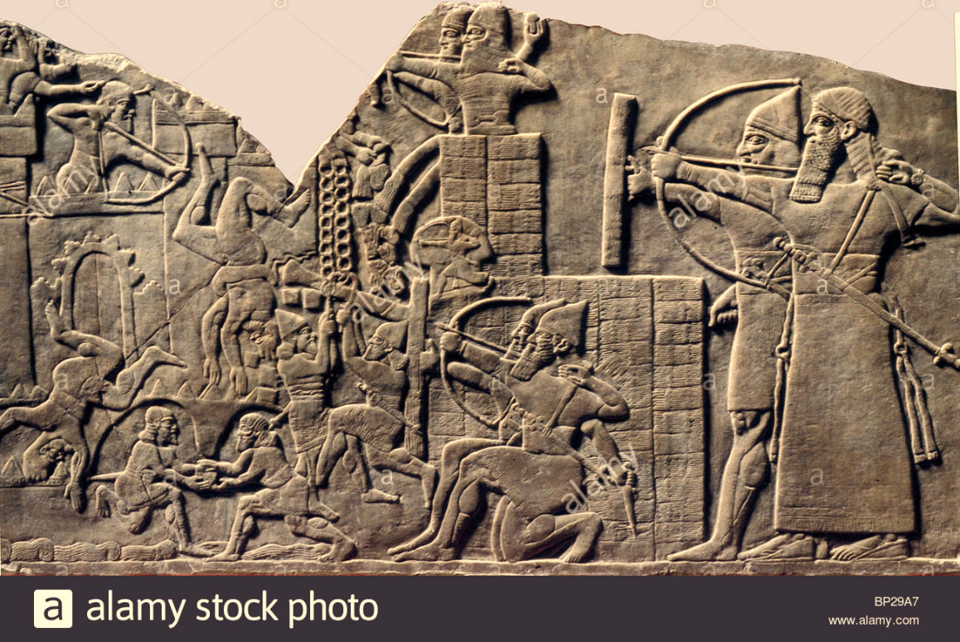
Hope Despite Destruction
Assyria, God’s Tool
10:5-19
Notes:
Isaiah dramatically states the twofold truth that His people are about to feel the rod of Assyria, but Assyria is but a rod, a tool, and as such is subject to the will and purpose ow the One who swings it. Assyria’s great sin of pride is the same sin that God was punishing Israel for, acting as if there were no God, exalting oneself in the place of God. Assyria’s power and glory does not make her immune from destruction and responsible to the One who power and glory are greater than hers.
Divided into three parts:
5:5-11 - Assyria is God’s tool, though she does not know it.
5:12-14 – expresses Assyria’s pride for which judgment is promised’
5:15-19 – tells the nature and extent of the coming judgment.

Slide 10
Hope Despite Destruction
“Woe to Assyria, the rod of My anger
and the staff in whose hand is My indignation. I will send him against an ungodly nation, and against the people of My wrath I will give him charge, to seize the spoil, to take the prey, and to tread them down like the mire of the streets.” (10:5-6)
Notes:
The idea that the enemy, who did not even know the LORD Yahweh, could be a rod in the hand of God was a revolutionary concept in Isaiah’s day. The Hebrews considered the Assyrians to the most “godless” and profane people they knew. Yet Isaiah has the audacity to say that the Assyrians are God’s tool to punish them and they are the godless and profane ones. How could this be?
Israel was more godless and more profane because it had more light.

Slide 11
Hope Despite Destruction
“Yet he does not mean so, nor does his heart think so; But it is in his heart to destroy, and cut off not a few nations. For he says, 'Are not my princes altogether kings? Is not Calno like Carchemish? Is not Hamath like Arpad? Is not Samaria like Damascus?” (10:7-9)
Notes:
Assyria did not see herself as a servant of Yahweh. They believed their personal and national eminence was due to their own achievements. They did not realize they were there because of the larger purposes of God.
Because Assyria failed to realize this fact, they believed their superior wealth and power gave them the right to sack the world. And the nations with which they conquered they did not considered to have any individual worth or uniqueness. They were just a number to check off on a list.

Slide 12
Hope Despite Destruction
“As my hand has found the kingdoms of the idols, whose carved images excelled those of Jerusalem and Samaria, as I have done to Samaria and her idols, shall I not do also to Jerusalem and her idols?” (10:10-11)
Notes:
Yahweh, who is He? Nothing more than any of the other worthless idols. They had subdued the other gods, what could a god of some out-of-the-way place like Jerusalem have over the other great gods? They failed to consider that Yahweh was different than the other god’s. For one there was no image of Him, because He was not part of this world. He was transcendent, and could not be conquered.

Slide 13
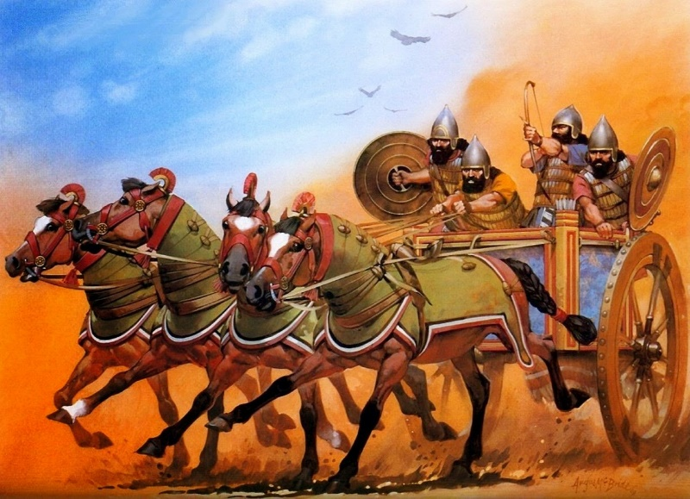
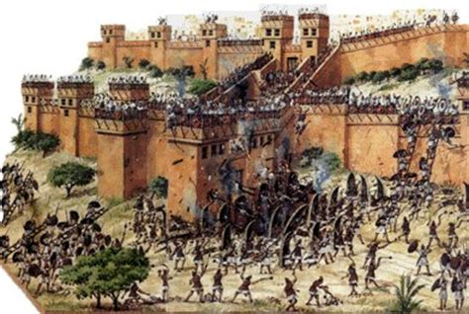
Hope Despite Destruction
The Destroyer Destroyed Assyria Under Judgment
10:12-19; 28-34
Notes:
Because Assyria did not see herself as a tool of God, but superior to Yahweh, judgment is pronounce upon the Assyria. The Destroyer is destroyed. The general context has been that Judah and Israel as a whole is judged for its arrogance. The immediate context is Assyria that Assyria is under judgment as well for its own arrogance. Verses 12-19 and 10:28-34 are parallel passages, 28-34 give a more graphic and concrete illustration of the point being made.
When the Sovereign is finished with his work on Mt; Zion, then Assyria herself will come under the wrath of God, a judgment which will make it plain that her boasting was unwarranted.

Slide 14
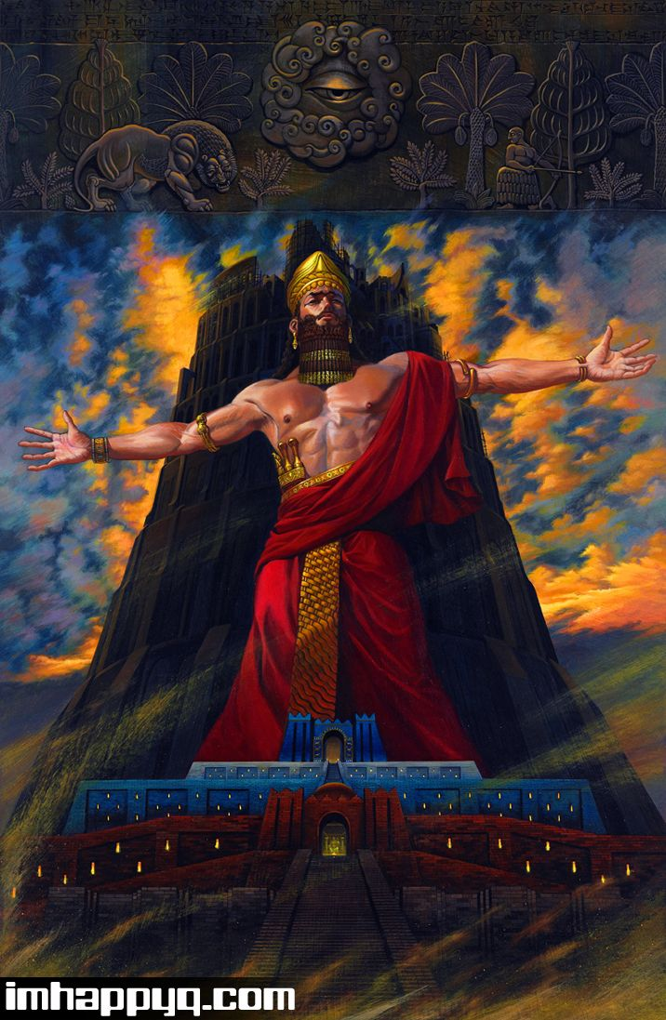
Hope Despite Destruction
Assyria’s Pride
10:12-14
Notes:
Assyria was not merely ignorant, but was arrogantly strutting about declaring its superiority over its neighbors. Like Nazi Germany who believed they very biologically superior to other races, turns out history proved them wrong.

Slide 15
Hope Despite Destruction
“Therefore it shall come to pass, when the Lord has performed all His work on Mount Zion and on Jerusalem, that He will say, "I will punish the fruit of the arrogant heart of the king of Assyria, and the glory of his haughty looks.” (10:12)
Notes:
Verse 12 functions as a transitional element making it super clear that what God accomplishes in Judah and Samaria is not done in spite of the LORD Yahweh, but because of Him, and the coming punishment upon Assyria is fully justified for her destructive and arrogant attitude.

Slide 16
Hope Despite Destruction
“For he says: ‘By the strength of my hand I have done it, and by my wisdom, for I am prudent; Also I have removed the boundaries of the people, and have robbed their treasuries; So I have put down the inhabitants like a valiant man.” (10:13)
Notes:
Assyria say, look what I have done! Look at who I am! Look at how powerful I am! Look at how smart I am!

Slide 17
Hope Despite Destruction
“My hand has found like a nest the riches of the people, and as one gathers eggs that are left, I have gathered all the earth; And there was no one who moved his wing, nor opened his mouth with even a peep.” (10:14)
Notes:
Look at how I am so strong I am over the weak and inferior people and how easy it is to take what I desire. And there is no one who even challenged my superiority.
God is at work in His world, even by those who do not even know Him. But they do know Him, don’t they? They are ignorant, but not totally. Ignorance is not a sin, but neither is it a defense. The sin comes in when a person or nation takes the praise for their own abilities and accomplishes to themselves when they know full well in their deepest heart/mind that the praise belongs to another, One superior to themselves.

Slide 18

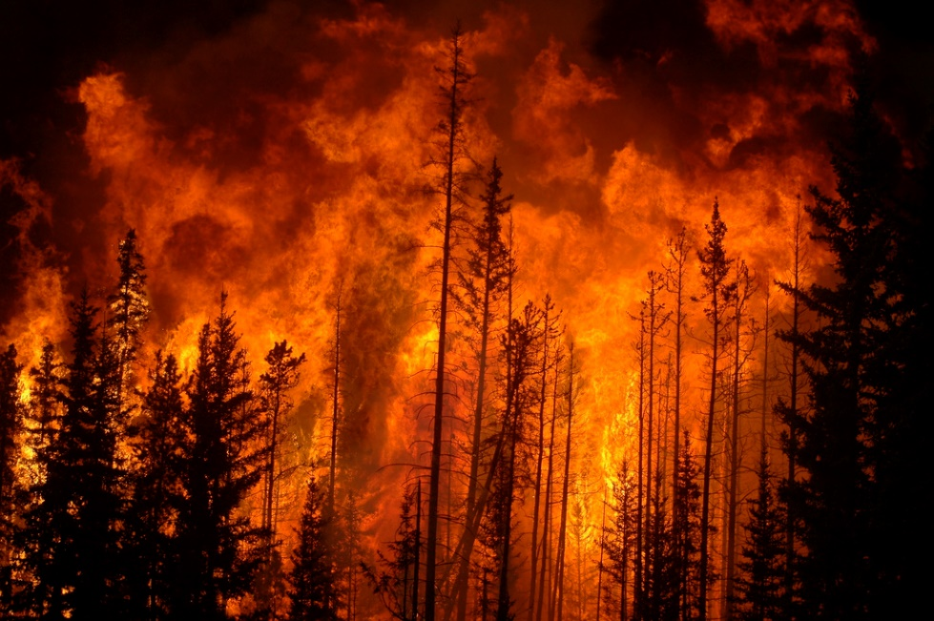
Hope Despite Destruction
Judgment Announced
10:15-19
Notes:
Because Assyria did not see herself as a tool of God, but superior to Yahweh, a word of judgment is announce upon the destroyer. Two metaphors are mixed together in this announcement: sickness and fire. “All the health, vigor, and glory in which Assyria exulted will be eaten away by disease and fire. All that will be left will be wasted, buried-out hulk. (a prophecy fulfilled in 605 BC)

Slide 19
Hope Despite Destruction
“Shall the ax boast itself against him who chops with it? Or shall the saw exalt itself against him who saws with it? As if a rod could wield itself against those who lift it up, or as if a staff could lift up, as if it were not wood!” (10:15)

Slide 20
Hope Despite Destruction
“Therefore the Lord [Sovereign], the Lord of hosts, will send leanness among his fat ones; And under his glory He will kindle a burning like the burning of a fire. So the Light of Israel will be for a fire, and his Holy One for a flame; It will burn and devour His thorns and his briers in one day.” (10:16-17)
Notes:
Isaiah stresses God’s ultimate authority when he calls Him the “Lord”, Adonai – “master”. God is the ruler of the world. Isaiah has seen the LORD will is high and lifted up Assyria and all who lift themselves up over the LORD will be brought low. Assyria’s vast army and glory mean nothing in comparison the Lord, almighty. All human works are but tinder, though some may be grass and some maybe a forest it makes little difference to a raging fire.

Slide 21
Hope Despite Destruction
“And it will consume the glory of his forest and of his fruitful field, both soul and body; And they will be as when a sick man wastes away. Then the rest of the trees of his forest will be so few in number that a child may write them.” (10:18-19)
Notes:
Again Isaiah stress that God is the ultimate authority, he calls him Sovereign, the ruler of the world. Though some nations are considered as briars and thorns (5-6) while others are towering forest the difference means little to a raging fire.
By the time Isaiah has published his vision, and by the exiles had read his prophecy both nations, Israel and Assyria were left desolated, like a fire.

Slide 22
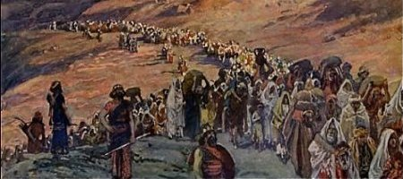
Hope Despite Destruction
Restoration Promised
10:20-27
Notes:
“The focus changes abruptly from Assyria to Israel with the promise that since Assyria is under God’s control, the destruction which she brings upon Israel will not be total but will be subject to God’s larger purposes.
There are two parts (20-23) concentrate on upon the remnant, a concept with both negative and positive aspects. The second part (24-27), offers hope that just as the Egyptian oppression was ended by divine deliverance, so too will the Assyrian oppression. Deliverance came by the hand of destruction of their enemies, which necessarily means hope for Israel, resulting in deliverance for Israel.

Slide 23
Hope Despite Destruction
“And it shall come to pass in that day
that the remnant of Israel, and such as have escaped of the house of Jacob, will never again depend on him who defeated them, but will depend on the LORD, the Holy One of Israel, in truth.” (10:20)
Notes:
“in the day” is a phrase that identifies a moment in when God’s hand [activity] is particularly seen in human history. Customarily, it is the hand of judgment. But her it is not merely for destructive terms but for constructive, for there will be a purified remnant which will emerge from the chaos of that day.
“the remnant of Israel” – Shear-jashub“ a remnant will return”. To king Ahaz it had a negative connotation. It pointed to a destruction from which only a small portion of Ahaz people will return. Yet it also has a positive connotation in its promise that some will survive to create a new nation. It is the most apt summary of the entire book, since it captures the interwoven themes of redemption and judgment that prevail from beginning to end.
In that day when the remnant will not depend Assyria the one who smit them [“defeated” not totally”] This is to show the sheer foolishness of putting trust in Assyria who had no concern for Judah’s best interests. Isaiah is looking to the day when the restored Israel will be wise enough to put her trust in God, the Holy One who really, truly cares for her, whose power is unique, and whose commitment to her is total. Her trust in the LORD in that day will be enduring trust, not one which is fickle and wavering.

Slide 24
Hope Despite Destruction
“The remnant will return, the remnant of Jacob, to the Mighty God. For though your people, O Israel, be as the sand of the sea, a remnant of them will return; The destruction decreed shall overflow with righteousness. For the Lord GOD of hosts will make a determined end in the midst of all the land.” (10:21-23)
Notes:
“The remnant will return” a direct use of “Shear-jashub is an indication of the connection of this passage to the overall section. It highlights the continuity of God’s people. It is an authentic representation of the ancient promise that God’s people, the physical line of Jacob will survive and someday thrive.
There will come a day when God’s government/kingdom will be established and His might demonstrated in His Anointed One, though the Might One will first come as a lamb and a child.
Though the promise that the people will not be annihilated, it is still true that the remnant will be but a fragment of the original. The promises to Abraham will not be revoked or nullified, they will be fulfilled with the physical descendants of Israel. But they cannot be used as a hedge to protect themselves from judgment, which apparently that was what some of them were doing in Isaiah’s day. They evidently were arguing that God’s promises to multiply them would be kept to the extent that they would always be a numerous people. Not so! Isaiah’s response was that it did not matter how numerous they might become, what truly matter was how righteous they might become. But because of their sin the Sovereign One had decreed their destruction and the number of their population will have nothing to do with the outcome.

Slide 25
Hope Despite Destruction
“Therefore thus says the Lord GOD of hosts: ‘O My people, who dwell in Zion, do not be afraid of the Assyrian. He shall strike you with a rod and lift up his staff against you, in the manner of Egypt. For yet a very little while and the indignation will cease, as will My anger in their destruction.” (10:24-25)
Notes:
Verses 24-27 focus our attention to the deliverance from Assyria’s oppression and destruction. The decreed destruction is not total and Israel will survive as it did earlier oppressions. And as we have seen thought the last 2000 years Israel has survive countless attempts to oppress and annihilate the Jews.
Harking on the great deliverances of the past and asserting that ultimately Zion has nothing to fear from Assyrian power but only from divine anger, which will soon be gone and spent, redirected toward Assyria itself. “The coming destruction which cannot be avoided is not a cause of despair. It becomes a reason for hope,” because a remnant shall return.
“If we can believe that the events of our lives are in the hands of and under the guidance of a providential loving Father, then even punishment my result in hope because his purposes are good and his power is unlimited” (Oswalt, p. 272)

Slide 26
Hope Despite Destruction
“My brethren, count it all joy when you fall into various trials, knowing that the testing of your faith produces patience… Blessed is the man who endures trials; for when he has been approved, he will receive the crown of life which the Lord has promised to those who love Him.: (James 1:2-3, 12)

Slide 27
Hope Despite Destruction
“Therefore thus says the Lord GOD of hosts: ‘O My people, who dwell in Zion, do not be afraid of the Assyrian. He shall strike you with a rod and lift up his staff against you, in the manner of Egypt. For yet a very little while and the indignation will cease, as will My anger in their destruction.” (10:24-25)
Notes:
God’s wrath is not forever, this passages give an indication of the fact. [A proof test?] Whatever people experience in the lake of fire it is not the result of the wrath of God. I would define the wrath of God as His temporal anger and punishment toward sin, not an eternal burning.

Slide 28
Hope Despite Destruction
“And the LORD of hosts will stir up a scourge for him like the slaughter of Midian at the rock of Oreb; as His rod was on the sea, so will He lift it up in the manner of Egypt.” (10:26)
Notes:
God’s anger against Israel’s enemies is illustrated by his handling of the Midianites when Gideon delivered them and when Moses raised the staff and destroyed the Pharaohs army when they drowned in the sea.

Slide 29
Hope Despite Destruction
“It shall come to pass in that day that his burden will be taken away from your shoulder, and his yoke from your neck, and the yoke will be destroyed because of the anointing oil.” (10:27)
Notes:
Burdens and yokes were ancient terms for servitude. Once again, God promises deliverance from the bondage which their own sin has brought them.
The picture drawn for us is an ox who has eaten so well, and worked so little that the very fat of its neck to an extent that it will break the yoke away.

Slide 30
Hope Despite Destruction
The Destroyer Destroyed Assyria Under Judgment
10:28-34
Notes:
10:28-34 are parallel passages to verses 12-19 , 28-34 give a more visual representation that the march to conquer the world seemingly was nearly superhuman, but her arrogance will not go unpunished with the result that the remnant of Israel will survive the onslaught.

Slide 31
Hope Despite Destruction
“He has come to Aiath, He has passed Migron; At Michmash he has attended to his equipment. They have gone along the ridge, they have taken up lodging at Geba. Ramah is afraid, Gibeah of Saul has fled…”

Slide 32
Hope Despite Destruction
“Lift up your voice, O daughter of Gallim! Cause it to be heard as far as Laish -- O poor Anathoth! Madmenah has fled, the inhabitants of Gebim seek refuge. As yet he will remain at Nob that day; He will shake his fist at the mount of the daughter of Zion, the hill of Jerusalem.” (10:27-32)

Slide 33
Hope Despite Destruction
“Behold, the Lord, the LORD of hosts, will lop off the bough with terror; Those of high stature will be hewn down, and the haughty will be humbled. He will cut down the thickets of the forest with iron, and Lebanon will fall by the Mighty One.” (10:33-34)
Notes:
It tells the tale of a great tree’s swift end. High and mighty brought down with a few cuts, not so no more.
Assyria is not unsurmountable. Assyrian is subject to God the Sovereign and her arrogance will not go unpunished. Anyone who leaves God out of the picture is doomed to fail in the end, which was in Assyria’s case surely borne out in time (701 BC).

Slide 34
Hope Despite Destruction
“And whoever exalts himself will be humbled, and he who humbles himself will be exalted.” (Matthew 23:12)

Slide 35
Hope Despite Destruction
“Therefore humble yourselves under the mighty hand of God, that He may exalt you in due time, casting all your care upon Him, for He cares for you.” (1 Peter 5:6-7)

Slide 36
Hope Despite Destruction
Doom to Bloom
Notes:
The entire unit makes the point that although Israel’s lack of trust in the LORD will have meant nearly total destruction at the hand of Assyria, that destruction is not God’s final word. Assyria too, will come under judgment and out of that judgment a remnant of Jacob’s descendants will return to God’s land. However, as 8:23-95 and 11:1-9 confirms that such a return will be under the guidance of an anointed descendent of David.” (Oswalt, p. 277-278) The root of Jesse will himself be the signal of their safe return. The Sovereign activity of God will be prominent. Judgment by the means of Assyria has been turned to deliverance from Assyria.
Doom has been turned to bloom. And it is all an expression of the sovereign grace of a just and faithful God.

Slide 37
The Vision of Isaiah

